Slide 1
From Telegraph to Text: How Undersea Cables Connects Us All
Instructor:
Notes:
PoweredTemplate.Com

Slide 2
Essential Questions and Task
What was Cyrus Field and the Atlantic Telegraph Company primary goal?
What were some of the technical issues encountered by the project?
What is the Engineering and Design Process?
Task: Connect, Problem Statement, Proper Citation of Web Research, and Discuss

Slide 3
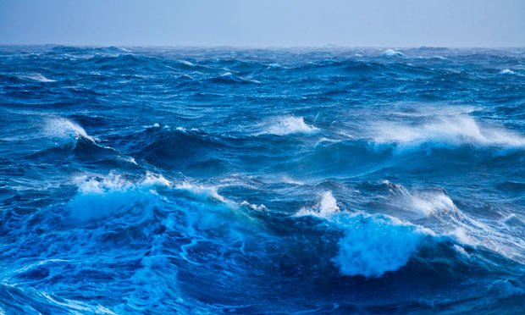
The Undersea Cable That Linked The World
This Photo by Unknown Author is licensed under CC BY
The dawn of instant global communication can be traced back to entrepreneur Cyrus West Field and his long-shot experiment to link the United States and Europe by telegraph in the 1850s.
Notes:
5 minute video

Slide 4
How was information delivered in the past ?
Speed of delivery was dependent on the means with how fast it traveled- person, boat or carriage.
1830s Electrical Telegram, messages sent by wires with electrical pulses translated into letters than words.
Morse Code
1,000 Telegraph cables laid down in major cities linking government and businesses.
Big Gap! No direct wire link across the ocean from the Americas to Europe.
Notes:
template as well as our others at http://poweredtemplate.com/global-ppt-powerpoint-templates.html

Slide 5
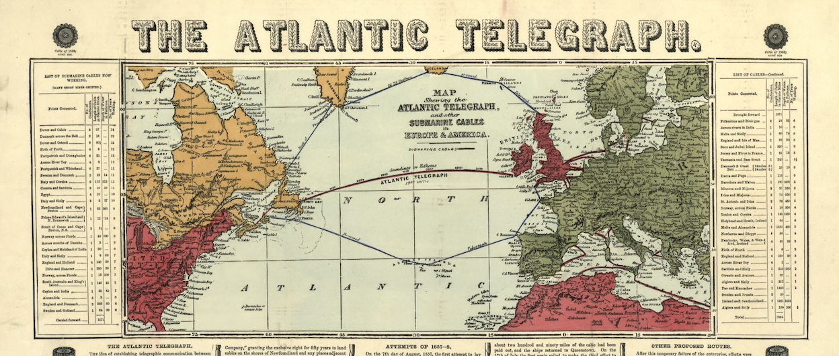
What was Cyrus West Field and the Atlantic Telegraph Company primary goal?
Notes:
Need to reference

Slide 6
Atlantic Cable Design
Protective Wire Outer Cover
18 strands of iron wire with 7 additional wires twisted together = 126 total
Coated with thick tar
Inner Insulation
Hemp yarn soaked in a mix of tar, pitch, linseed, and beeswax
Gutta Perche
Gum from a tropical tree in Singapore
Heat: easily molds into shapes and keeps the shape when cooled.
Good insulation for underwater cables
Telegraph Wire
7 copper wire strand
1 straight with 6 wires twisted around it

Slide 7
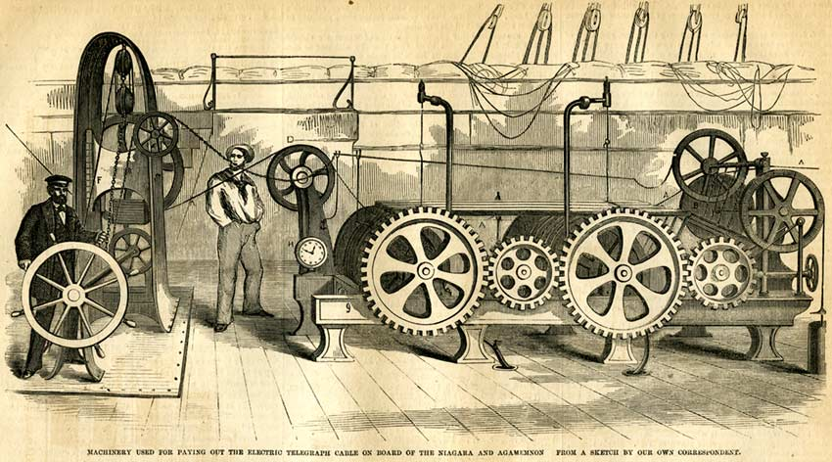
Machinery used to lay out the cable
Notes:
https://atlantic-cable.com/Cables/1857-58Atlantic/index.htm

Slide 8
What were some of the technical problems encountered by the project?
Insulation from the cable would gunk up the machine
Tar harden the grooves and would throw the cable off its wheel
Cable clamped
Tar insulation on the cable would soften if oil was applied to the gears
Cable would kink and had to be straightened
If a machinist applied the brakes too quickly or strongly the cable would snap

Slide 9
Before Another Attempt….
Redesign the "Paying Out Machine"
Institute safety precautions
Appropriately train the crew on how to use and troubleshoot the machine
Excerpt from Cyrus Field Big Dreams, p. 88

Slide 10
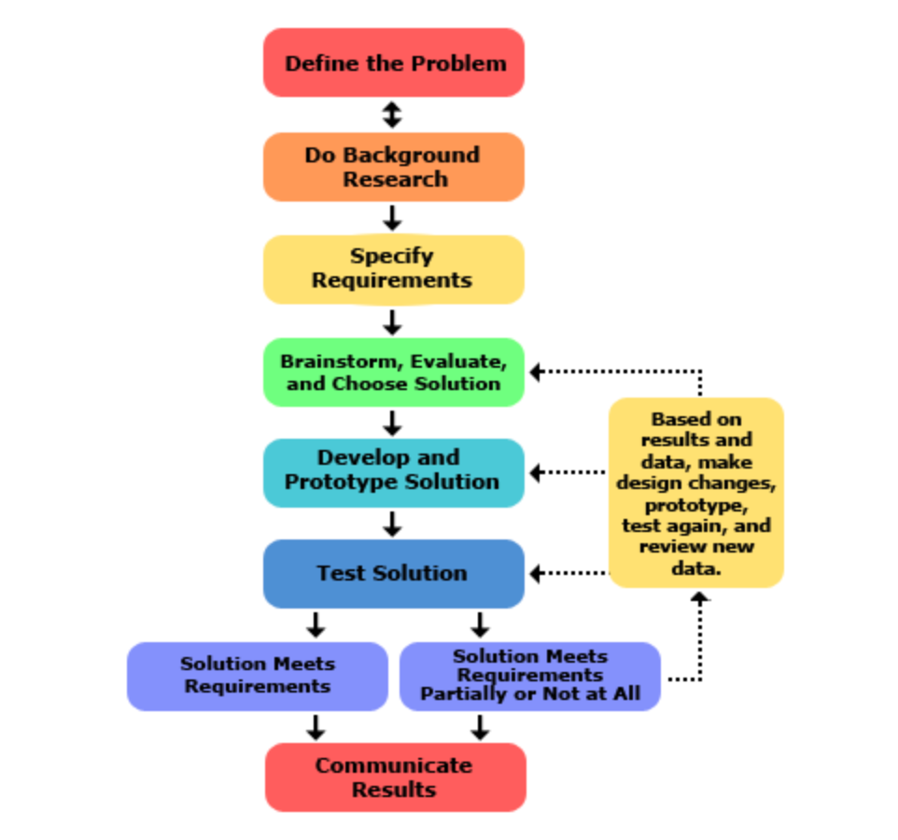
APA Citation
Supporting Paragraph
Notes:
APA Citation Link
Supporting Paragraph Link

Slide 11
Task
What is the problem or need? Who has the problem or need? Why is it important to solve? The statement should address which or how will the independent variable affect the dependent variable.
American Psychological Association (APA) format. APA is used for technical and scientific works. Examples
Begin with a topic sentence. This statement reinforces your point. Use specific facts from your research and specific examples to enhance and clarify the point you are making.
Problem Statement
2. Cite website sources in APA format
3. Supporting Paragraph
Notes:
APA Link

Slide 12
Photograph courtesy of Bill Burns, www.atlantic-cable.com

Slide 13
REFERENCES
Gordon, John Steele (2002). A Thread Across the Ocean: The Heroic Story of the Transatlantic Cable (2nd ed). Walker.
Cowan, Mary Morton (2018). Cyrus Field’s Big Dream: The Daring Effort to Lay the First Transatlantic Cable (1st ed). Calkins Creek.
Freezee, W. (1978). The First Trans-Atlantic Cable. Journal of the Washington Academy of Sciences, 68(1), 3-13. Retrieved March 30, 2021, from http://www.jstor.org/stable/24537173
Glover, Bill (2020, Oct 28) History of the Atlantic Cable & Undersea Communications from the first submarine cable of 1850 to the worldwide fiber optic network.Cabot Strait Cable and 1857-58 Atlantic Cables. https://atlantic-cable.com/Cables/1857-58Atlantic/index.htm

